Slide 1
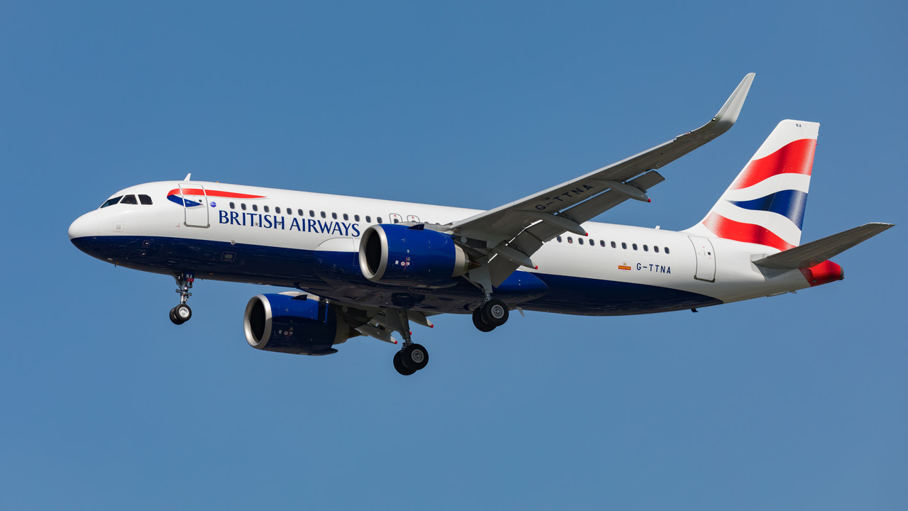
British Airways Customers’ Reviews Analysis

Slide 2
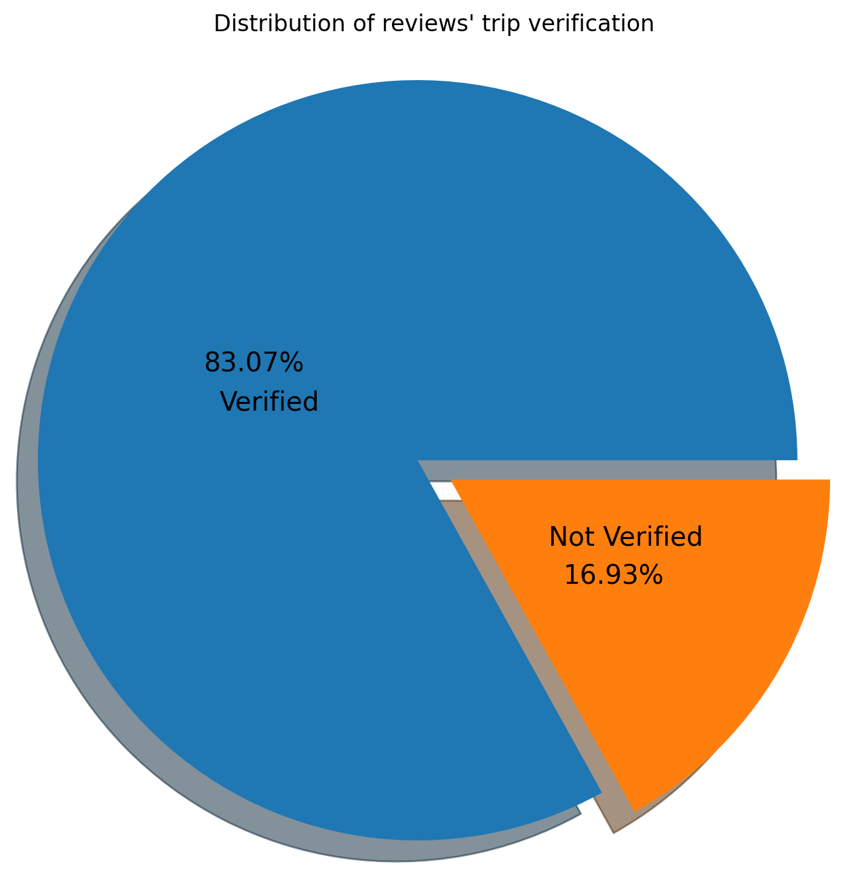
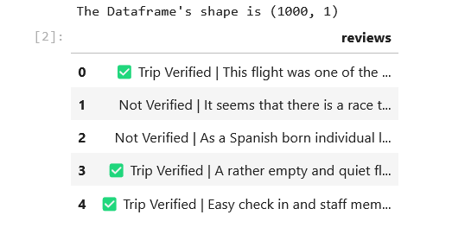
Data Summary: The data consists of 1,000 online reviews with some of them having their trip verified and others not.

Slide 3
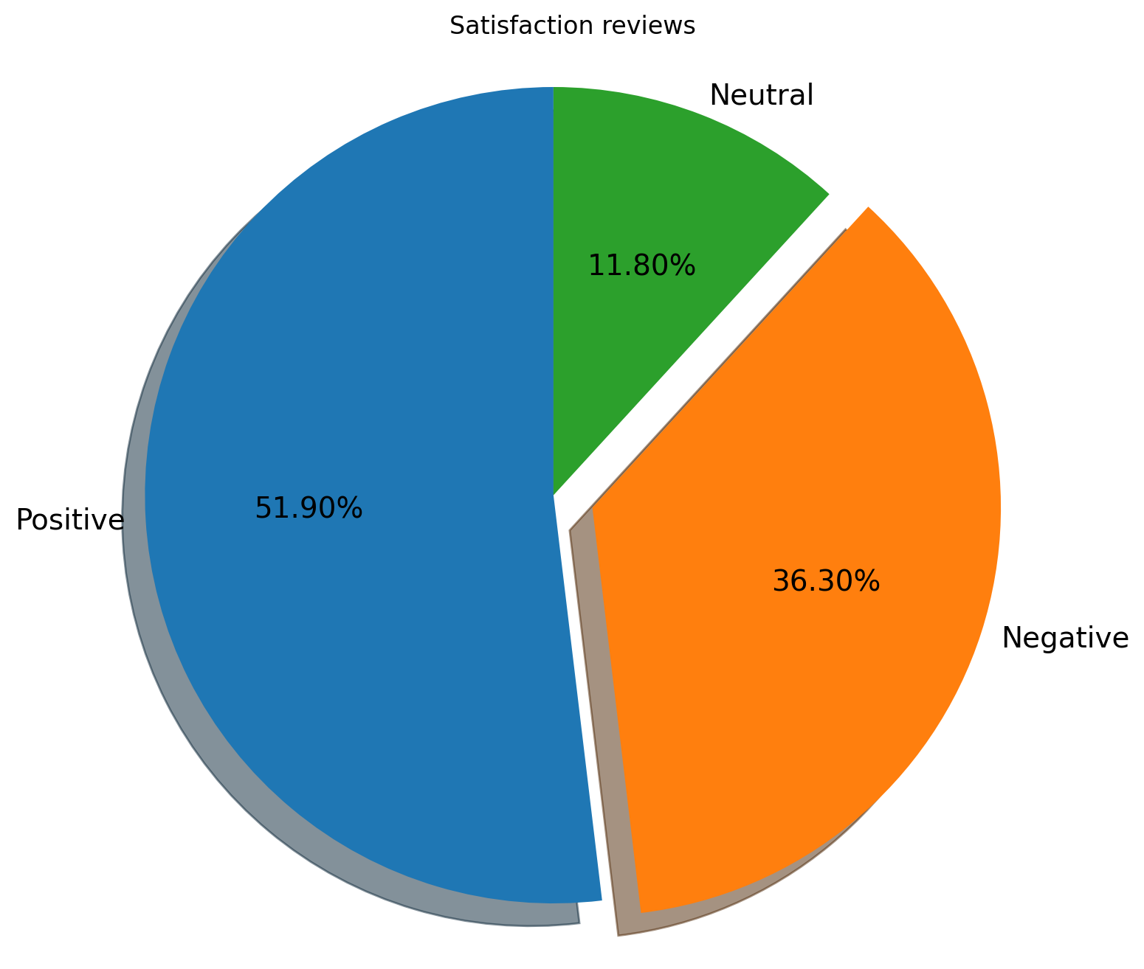
Sentiment Analysis: The reviews has been divided into 3 segments based on their review’s sentiment.

Slide 4
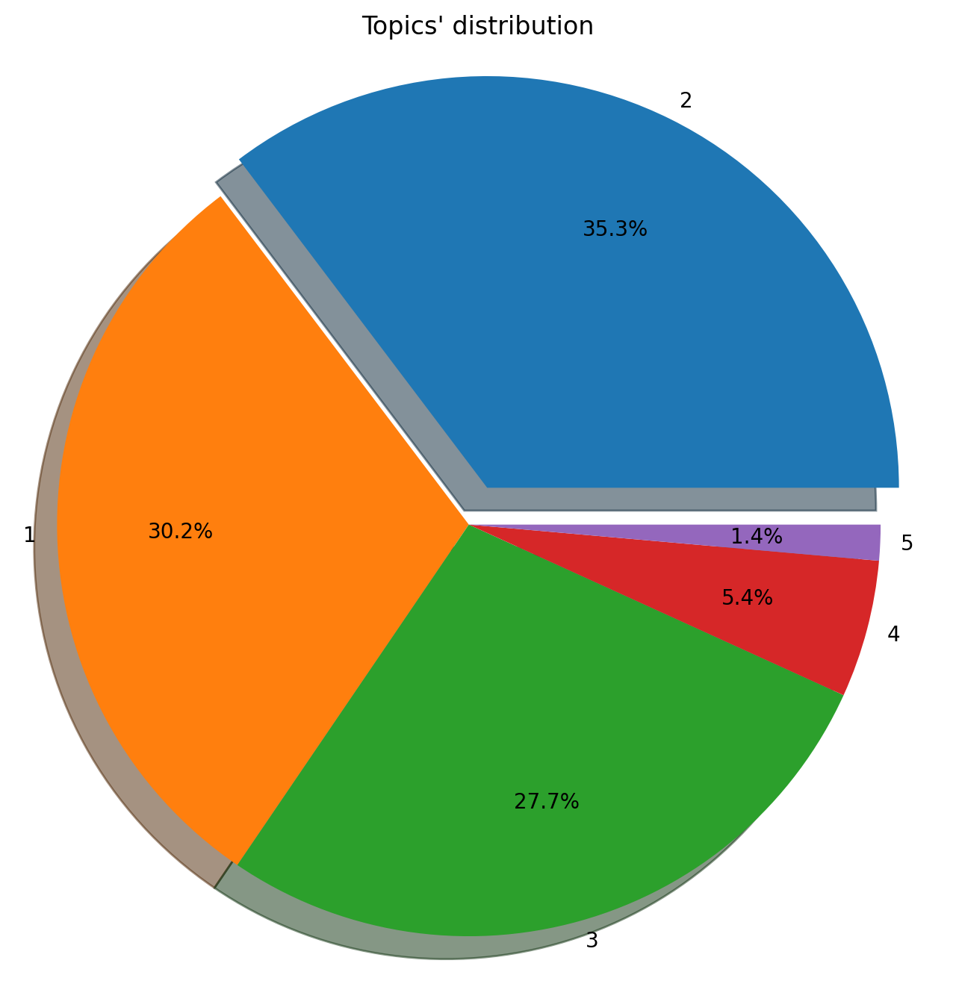
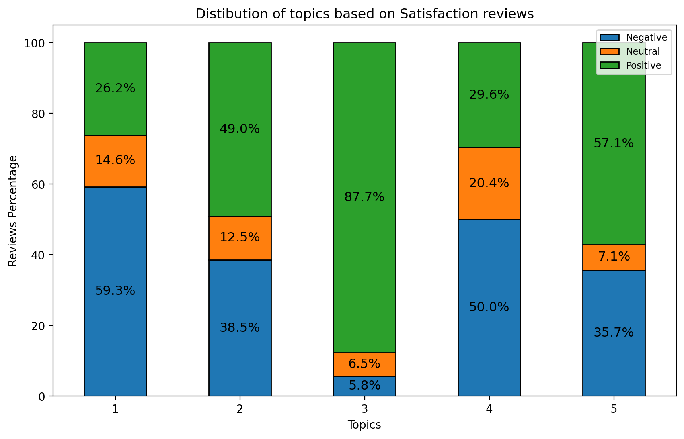
Topic Modelling: The reviews is then divided into 5 main topics according to the most frequent ones.

Slide 5
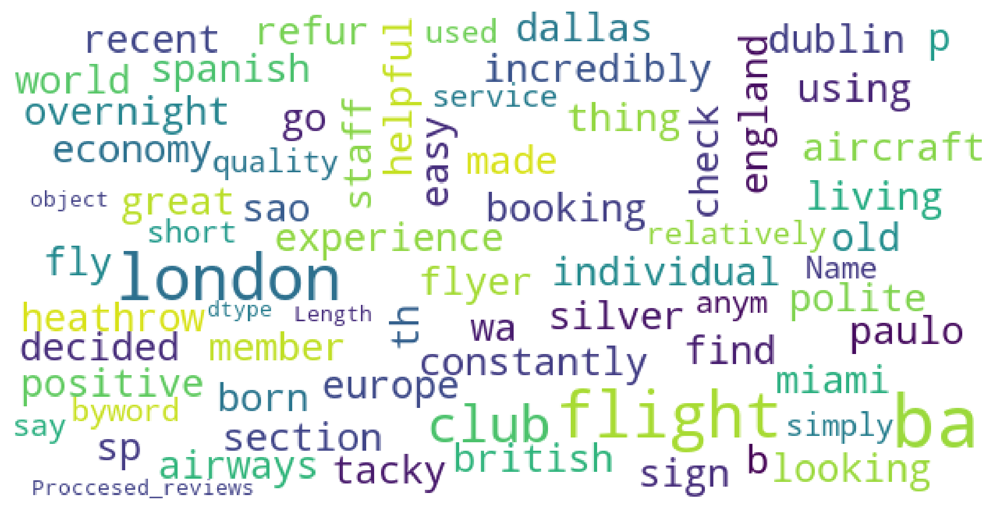
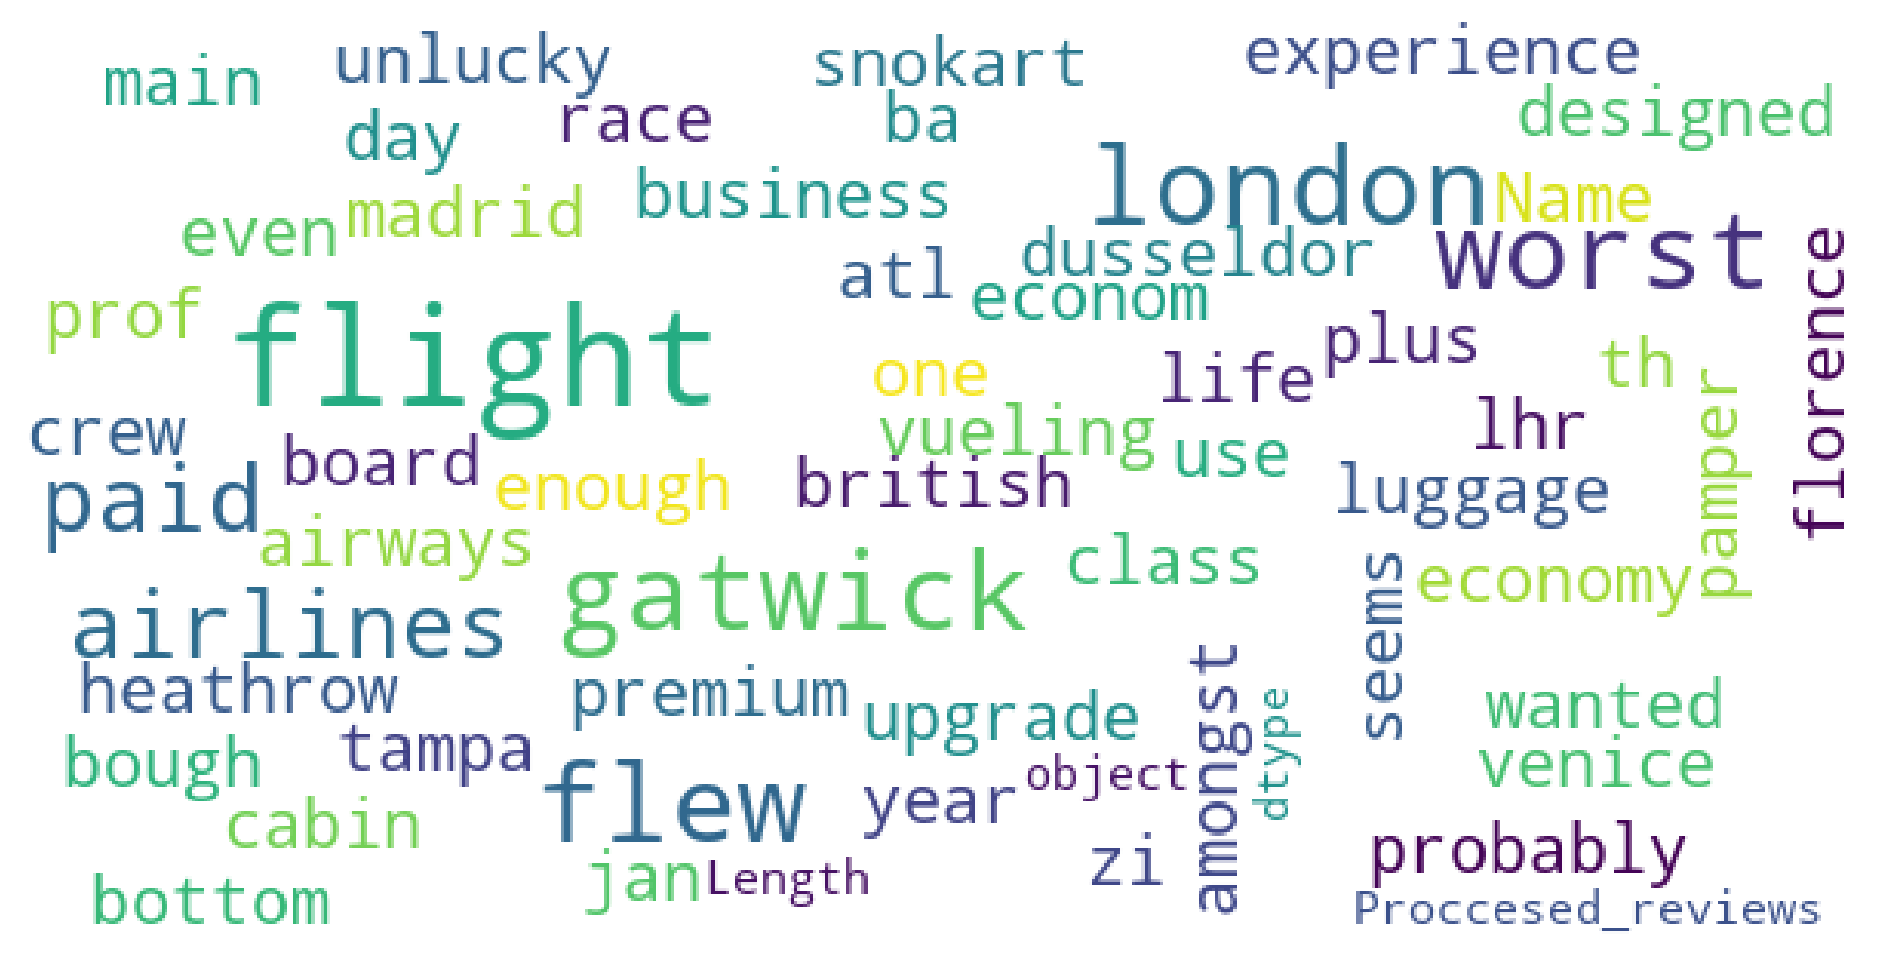
Word Cloud:
Positive reviews:
Negative reviews:

